Slide 1
ANALYZING THE USER BEHAVIOR TO IMPROVE E-COMMERCE BUSINESS -AN WEB USAGE BASED APPROACH

Slide 2
CONTENTS
ABSTRACT
INTRODUCTION
ANALYSIS OF THE LOG FILE
PRODUCT PERSPECTIVE
OVERVIEW OF BUSINESS INTELLIGENCE
USER IDENTIFICATION
SESSION IDENTIFICATION
PATTERN DISCOVERY
PATTERN ANALYSIS
RESULTS
CONCLUSION
REFERENCES

Slide 3
ABSTRACT
E-business management is an on-going process of understanding consumer needs and developing online solutions to meet those needs. This paper mainly focuses on user identification and knowing his behavior by maintaining each user profile in database and apply this in e-commerce business improvement. It uses the methods that introduces the concept of Web mining and describes the process of Web mining in detail. The paper mainly takes log file generated from tomcat server and apply the preprocessing using efficient algorithms, further pattern discovery is applied. Finally it establish the relationship between Web mining and e-commerce and how to use Web mining technology in e-commerce

Slide 4
INTRODUCTION
E-business management is an on-going process of understanding consumer needs and developing online solutions to meet those needs.
Mainly focuses on user identification and knowing his behavior by maintaining each user profile in database and apply this in e-commerce business improvement.
Introduce a web mining solution to e-commerce to discover hidden patterns and business strategies from their customer and web data.
Finally it concludes the relationship between Web mining and e-commerce and how to use Web mining technology in e-commerce.

Slide 5
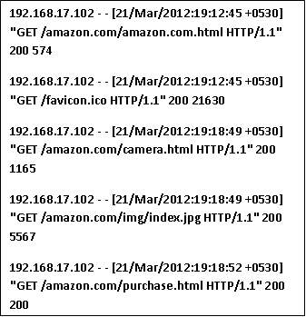
ANALYSIS OF THE LOG FILE

Slide 6
PRODUCT PERSPECTIVE
The information in the server web log file is taken through several phases.
A) Data Collection.
B) Data pre processing.
C) Pattern discovery.
D) Pattern analysis.
After the data pre processing phase we apply user identification algorithm for identifying the user’s surfing on web and understanding their behavior.
This analyzed data is presented to the website owner using our software for his website and therefore this helps his e-commerce business improvement.

Slide 7
OVERVIEW OF BUSINESS INTELLIGENCE
Website Improvement
Business
Intelligence

Slide 8
USER IDENTIFICATION
For analyzing user access behaviours, unique users must be identified.
Requests from the same IP address can be regarded as from the same user and put into the same group under that user.
The agent filed in web logs records information on the client browser and operating system.
The agent type may not be the same in many cases, it is quite reasonable to assume that each different agent type for the same IP address represents a different user.

Slide 9
SESSION IDENTIFICATION
The goal of session identification is to divide web logs of each user into individual access sessions.
The simplest method is to set a timeout threshold.
If the difference between the request time of two adjacent records from a user is greater than the timeout threshold, it can be considered that a new access session has started.

Slide 10
ALGORITHM FOR FIELD EXTRACTION
Input: Log File
Output: DB
Begin
1. Open a DB connection
2. Create a table to store log data
3. Open Log File
4. Read all fields contain in Log File
5. Separate out the Attribute in the string Log
6. Extract all fields and Add into the Log Table (LT)
7. Close a DB connection and Log File
End

Slide 11
ALGORITHM FOR DATA CLEANING
Input: Log Table (LT)
Output: Summarized Log Table (SLT)
‘*’ = access pages consist of embedded objects
(i.e .jpg, .gif, etc)
‘**’ =successful status codes and requested methods (i.e
200, GET etc)

Slide 12
Begin
1. Read records in LT
2. For each record in LT
3. Read fields (Status code, method)
4. If Status code=‘**’and method= ‘**’ and record not equal to previous record.
Then
5. Get IP_address and URL_link
6. If suffix.URL_Link= {*.gif,*.jpg,*.css}
Then
7. Remove suffix.URL_link
8.Save IP_sddress, time, URL_Link, method and status code.
End if
Else
10. Next record
End if
End

Slide 13
PATTERN DISCOVERY
Clustering of users help to discover groups of users with similar navigation patterns (provide personalized Web content).
Association Rules discover correlations among pages accessed together by a client in time order.
Sequential Patterns extract frequently occurring inter-session patterns such that the presence of a set of items is followed by another item

Slide 14
For web usage mining, association rules can be used to find correlations between web pages (or products in an e-commerce website) accessed together during a server session.
Discovery of such rules for organizations engaged in electronic commerce can help in the development of effective marketing strategies. But, in addition, association rules discovered from WWW .
This correlation might suggest that this information should be moved to a higher level to increase access to scanner.html

Slide 15
PATTERN ANALYSIS
Unique identification of the user.
User Behavior.
Frequently visited Web Pages.
Items sold to the maximum number.

Slide 16
RESULTS
INPUT
Website name.
OUTPUT
Decreasing order of purchased items.
Decreasing order of time spent on web pages with no purchase.
Three interested web pages with maximum visited users.
Number of unique users visited the website and number of users purchased the items.

Slide 17
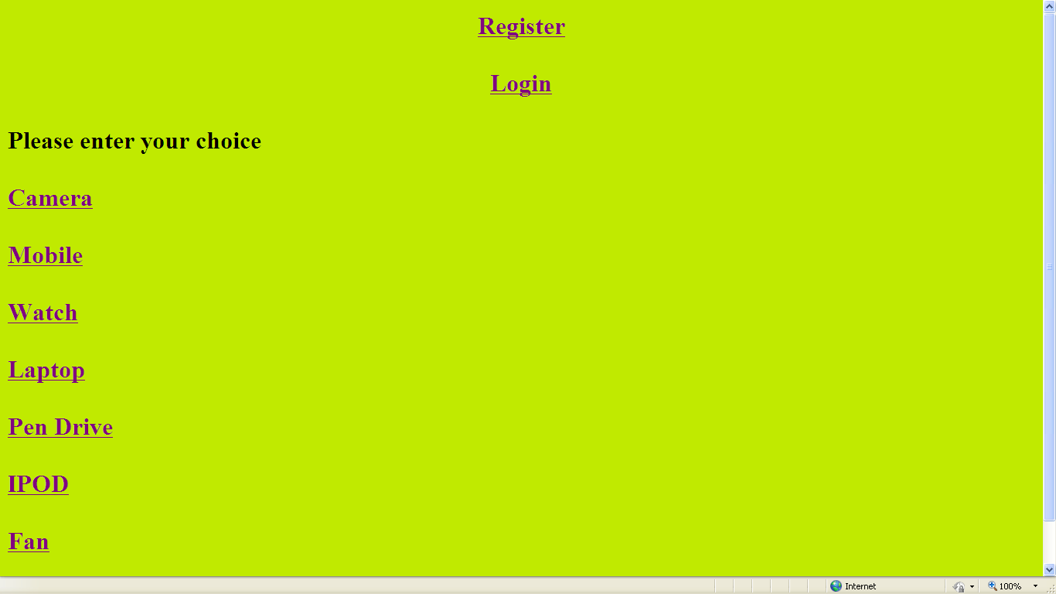
Table 2:amazon.com website to browse

Slide 18
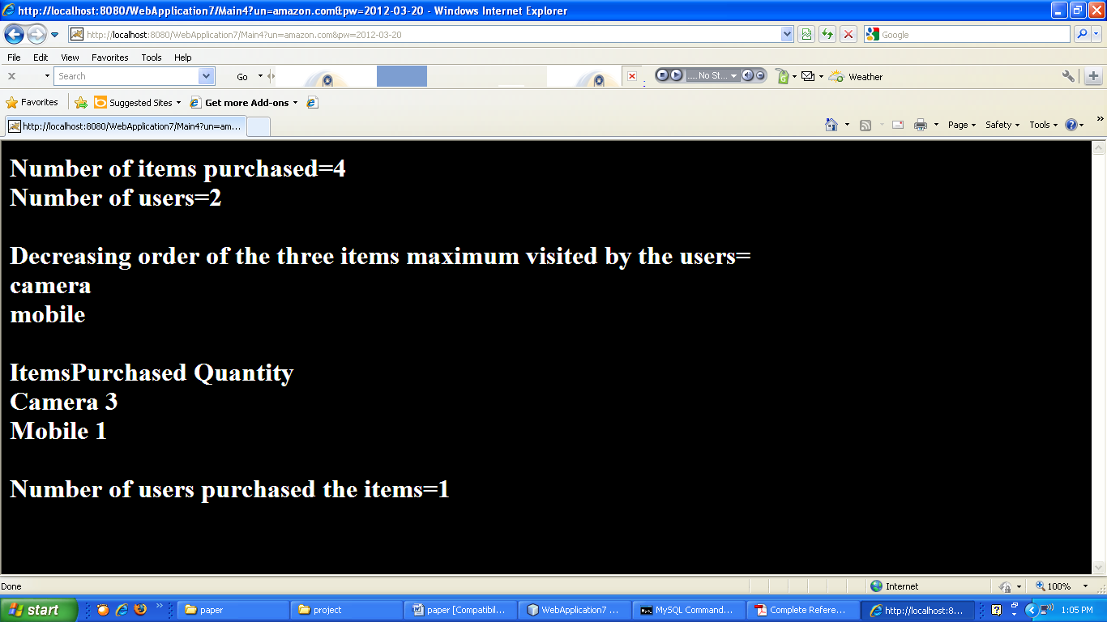

Slide 19
APPLICATION AREAS
Shortening Paths of High visit Pages
Eliminating or Combining Low Visit Pages
Redesigning Pages to help User Navigation
Redesigning Pages For Search Engine Optimization
Help Evaluating Effectiveness of Advertising Campaigns

Slide 20
CONCLUSION
A way to obtain it consists in understanding the user's browsing behavior, analyzing the web log files with data mining techniques.
The ideal structure of a web site should support the visitors in finding such information.
Studying visitors behavior is important in order to create more attractive contents, to predict her/his preferences, and to prepare links with suggestions, among others.
These research initiatives aim at facilitating web site navigation.

Slide 21
REFERENCES
R. Cooley, B. Mobasher, and J. Srivastava, “Data preparation for mining World WideWeb browsing patterns,” Knowledge and Information Systems
IEEE papers on “web usage mining” and “e- commerce business improvement”.
Jaideep Srivastava , Robert Cooley, Mukund Deshpande, Pang-Ning Tan, and Web Usage Mining: Discovery and Applications of Usage Patterns from Web Data.
G. Castellano, A. M. Fanelli, M. A. Torsello. “Log Data Preparation for Mining Web Usage Patterns”. IADIS International Conference Applied Computing 2007, pg 371-378.
José Roberto de Freitas Boullosa. "An Architecture for Web Usage Mining".
Yan Wang.” Web Mining and Knowledge Discovery of Usage Patterns”. CS 748T Project. February, 2000.
Martinez E. Karamcheti V. “A Prediction Model for User Access Sequence" .In WEBKDD Workshop: Web Mining for usage Patterns and user Profile, July 2002.

Slide 22
THANK YOU

